Slide 1
Software Development Lifecycle models
Модели разработки программного обеспечения
“You’ve got to be very careful if you don’t know where you’re going, because you might not get there…”

Slide 2
План
Что такое «Цикл Разработки программного обеспечения»?
Зачем нужно «моделирование» разработки?
Основные подходы при разработке программного обеспечения
Традиционные подходы (SDLC models)
Быстрые и современные (Agile models) подходы
Сильные и слабые стороны различных подходов
Примеры моделей разработки
Waterfall / Whirlpool, V-shaped, Incremental, Prototyping, Spiral
Scrum, RUP, XP, FDD

Slide 3
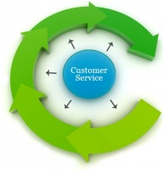
Жизненный Цикл Разработки ПО
(Life Cycle)
Постановка задачи
???
Внедрение / Использование полностью готового продукта

Slide 4
Модель жизненного цикла разработки ПО
Модель жизненного цикла программного обеспечения — структура, содержащая процессы, действия и задачи, которые осуществляются в ходе разработки, использования и сопровождения программного продукта.
Как эффективно управлять всеми этими процессами, действиями и задачами?

Slide 5
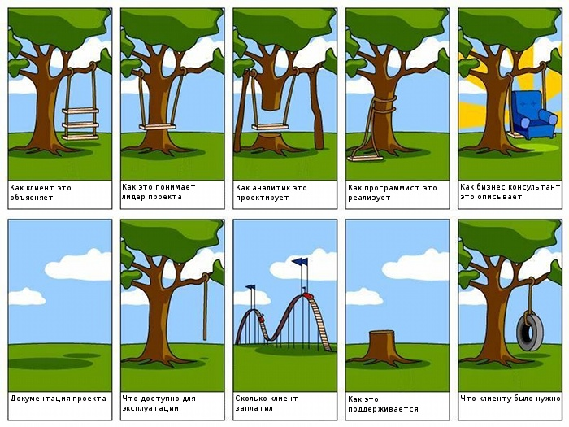
Модель жизненного цикла разработки ПО
Внести порядок в хаос
Смоделировать поведение системы
Определить действующих лиц
Определить все роли
Определить все обязанности
Определить все ответственности

Slide 6
Традиционные подходы к разработке ПО
Шаг 1: постановка задачи
Шаг 2: написание программы
Шаг 3: тестирование
Шаг 4: готовое решение

Slide 7
Waterfall model
Each phase must be completed fully before the next phase can begin.
Definition Study/Analysis
Requirements
Construction/
Implementation
Testing
Deployment
Support

Slide 8
Waterfall model
Advantages of waterfall model:
This model is simple and easy to understand and use.
It is easy to manage due to the rigidity of the model – each phase has specific deliverables and a review process.
In this model phases are processed and completed one at a time. Phases do not overlap.
Waterfall model works well for smaller projects where requirements are very well understood.
Disadvantages of waterfall model:
Once an application is in the testing stage, it is very difficult to go back and change something that was not well-thought out in the concept stage.
No working software is produced until late during the life cycle.
High amounts of risk and uncertainty.
Not a good model for complex and object-oriented projects.
Poor model for long and ongoing projects.
Not suitable for the projects where requirements are at a moderate to high risk of changing.

Slide 9
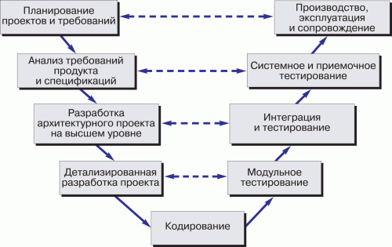
V-model
Each phase must be completed before the next phase begins.
Testing of the product is planned in parallel with a corresponding phase of development

Slide 10
V-model
Advantages of V-model:
Simple and easy to use.
Testing activities like planning, test designing happens well before coding. This saves a lot of time. Hence higher chance of success over the waterfall model.
Proactive defect tracking – that is defects are found at early stage.
Avoids the downward flow of the defects.
Works well for small projects where requirements are easily understood.
Disadvantages of V-model:
Very rigid and least flexible.
Software is developed during the implementation phase, so no early prototypes of the software are produced.
If any changes happen in midway, then the test documents along with requirement documents has to be updated.

Slide 11
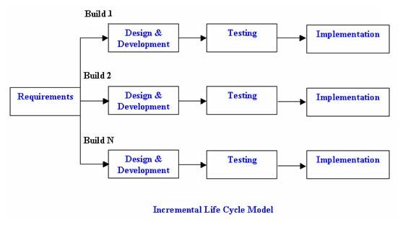
Incremental model
The whole requirement is divided into various builds.
~“multi-waterfall” cycle

Slide 12
Incremental model
Advantages of Incremental model:
Generates working software quickly and early during the software life cycle.
This model is more flexible – less costly to change scope and requirements.
It is easier to test and debug during a smaller iteration.
In this model customer can respond to each built.
Lowers initial delivery cost.
Easier to manage risk because risky pieces are identified and handled during it’d iteration.
Disadvantages of Incremental model:
Needs good planning and design.
Needs a clear and complete definition of the whole system before it can be broken down and built incrementally.
Total cost is higher than waterfall.

Slide 13
Prototyping
Instead of freezing the requirements before a design or coding can proceed, a throwaway prototype is built to understand the requirements.
Requirements Gathering
Quick Design
Building Prototype
Product
Development
and Testing
Refining Prototype
Customer Evaluation

Slide 14
Prototyping
Advantages of Prototype model:
Users are actively involved in the development
Since in this methodology a working model of the system is provided, the users get a better understanding of the system being developed.
Errors can be detected much earlier.
Quicker user feedback is available leading to better solutions.
Missing functionality can be identified easily
Confusing or difficult functions can be identified Requirements validation, Quick implementation of, incomplete, but functional, application.
Disadvantages of Prototype model:
Leads to implementing and then repairing way of building systems.
Practically, this methodology may increase the complexity of the system as scope of the system may expand beyond original plans.
Incomplete application may cause application not to be used as the full system was designed Incomplete or inadequate problem analysis.

Slide 15
Традиционные подходы к разработке ПО
Недостатки
В большинстве случаев требования должны быть известны заранее
Сложная интеграция, внедрение, поддержка и дальнейшая разработка системы
Малая возможность для пользователя системы увидеть её до конца разработки
Тестирование (в т.ч. системное тестирование) выполняется в конце разработки

Slide 16
Традиционные подходы к разработке ПО
Сильные стороны
Модели легко-понятны, легко-применимы, легко-осуществимы
Могут легко применяться для сотрудников невысокой квалификации
Определяют чёткие требования к продукту
Относительная легкость управления процессом
Отлично работают, когда качество более важно, чем стоимость или сроки разработки

Slide 17
Традиционные или Современные (Agile)?
Working Software
OVER
Comprehensive Documentation
Individuals and interactions
OVER
Process and Tools
Customer collaboration
OVER
Contract
Responding to change
OVER
Following a Plan

Slide 18
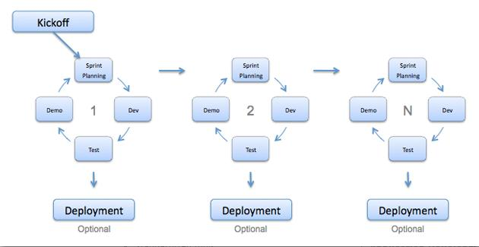
Быстрые и современные подходы
Agile
(type of Incremental model)
Small incremental releases with each release building on previous functionality.
Each release is thoroughly tested to ensure software quality is maintained.

Slide 19
Agile approach
Advantages of Agile approach:
Customer satisfaction by rapid, continuous delivery of useful software.
People and interactions are emphasized rather than process and tools. Customers, developers and testers constantly interact with each other.
Working software is delivered frequently (weeks rather than months).
Face-to-face conversation is the best form of communication.
Close, daily cooperation between business people and developers.
Continuous attention to technical excellence and good design.
Regular adaptation to changing circumstances.
Even late changes in requirements are welcomed
Disadvantages of Agile approach:
In case of some software deliverables, especially the large ones, it is difficult to assess the effort required at the beginning of the software development life cycle.
There is lack of emphasis on necessary designing and documentation.
The project can easily get taken off track if the customer representative is not clear what final outcome that they want.
Only senior programmers are capable of taking the kind of decisions required during the development process. Hence it has no place for newbie programmers, unless combined with experienced resources.

Slide 20
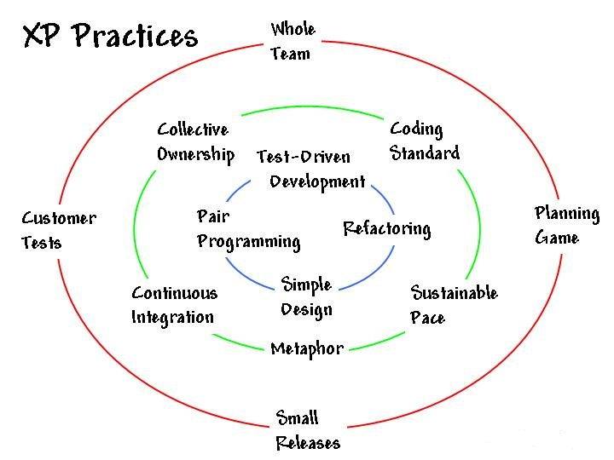
Extreme Programming (XP)

Slide 21
Extreme Programming (XP)
Advantages of XP:
Emphasis on customer involvement, teamwork and communication
Programmer estimates before committing to a schedule
Emphasis on responsibility for quality
Continuous measurement
Consistent with most modern development methods.
Simple design
Frequent redesign, or refactoring
Having engineers manage functional content
Frequent, extensive testing
Continuous reviews
Disadvantages of XP:
A methodology is only as effective as the people involved
Often used as a means to bleed money from customers through lack of defining a deliverable
Lack of structure and necessary documentation
Only works with senior-level developers
Incorporates insufficient software design
Requires meetings at frequent intervals at enormous expense to customers
Requires too much cultural change to adopt
Can lead to more difficult contractual negotiations
Impossible to develop realistic estimates (no one knows the entire scope/requirements in the start)
Can increase the risk of scope creep due to the lack of detailed requirements documentation
Agile is feature driven; non-functional quality attributes are hard to be placed as user stories

Slide 22
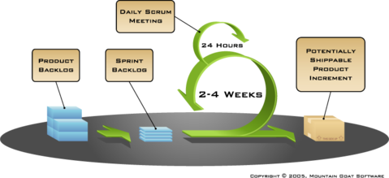
Scrum
Scrum roles:

Slide 23
Scrum
Advantages of Scrum:
Agile scrum helps the company in saving time and money.
Due to short sprints and constant feedback, it becomes easier to cope with the changes.
Daily meetings make it possible to measure individual productivity. This leads to the improvement in the productivity of each of the team members.
Issues are identified well in advance through the daily meetings and hence can be resolved in speedily
It is easier to deliver a quality product in a scheduled time.
The overhead cost in terms of process and management is minimal thus leading to a quicker, cheaper result.
Disadvantages of Scrum:
If a task is not well defined, estimating project costs and time will not be accurate. In such a case, the task can be spread over several sprints.
If the team members are not committed, the project will either never complete or fail.
It is good for small, fast moving projects as it works well only with small team.
This methodology needs experienced team members only. If the team consists of people who are novices, the project cannot be completed in time.
Scrum works well when the Scrum Master trusts the team they are managing. If they practice too strict control over the team members, it can be extremely frustrating for them, leading to demoralization and the failure of the project.
If any of the team members leave during a development it can have a huge inverse effect on the project evelopment.

Slide 24
Преимущества Agile разработки
Преимущества:
Простота разработки;
чёткое измерение;
каждая задача оценена;
фокусирует группу разработки;
направленность на результат;
гибкость

Slide 25
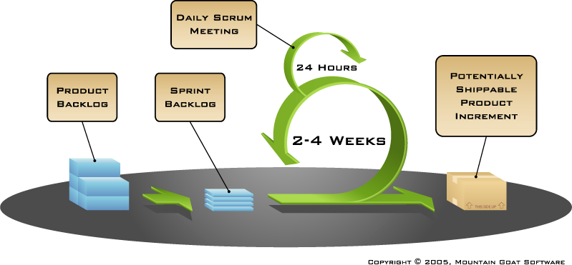
Повторяющийся цикл Scrum разработки
Artifacts:
Roles:
Team Master
Team
Product Owner

Slide 26

Software Development Lifecycle models
Traditional:
Waterfall / Whirlpool model
V-model
Prototyping Model
Spiral model
Agile:
Scrum
Rational Unified Process (RUP)
Extreme Programming (XP)
Feature Driven Development (FDD)

Slide 27
Вопросы
Какие Software Development Lifecycle Models вы сегодня изучили?
Почему традиционные модели могут быть сложными для применения?
Опишите в общих чертах жизненный цикл разработки ПО (Software Developing Lifecycle process)
Какие основные принципы Agile разработки вы знаете?
Какие ключевые моменты Agile моделей?
Если бы вы были Менеджером Проекта, какую модель разработки вы бы выбрали и почему?

